Slide 1

Group 19
Project Presentation
x21321771@student.ncirl.ie
x21178691@student.ncirl.ie
x21226695@student.ncirl.ie
x21437616@student.ncirl.ie
Jake Macken,
Adam Malone
Kyle White
Daniel O’Connor

Slide 2






Content
Technologies and other tools we used to help create our application
Our Project Plan and the Progress to Date
Pre-recorded video demo of our application
Questions
Challenges we faced so far
Introduction – Discussing our Application Idea and our Business Plan

Slide 3

Introduction
Good evening,
In this presentation we will be detailing the work we have done on our project so far, some problems we have encountered throughout the project, and solutions we have implemented.
We will also discuss the idea of our application, as well as our business plan moving forward.

Slide 4

Application Idea

Slide 5
Application Idea
Create a streamlined, user-friendly application that allows the user to easily share files with groups.
To send files in a safe way that retains all the data without fear of corruption or loss.
Provide an unlimited amount of space for users to store.
Allow the user to send any form of file type.

Slide 6
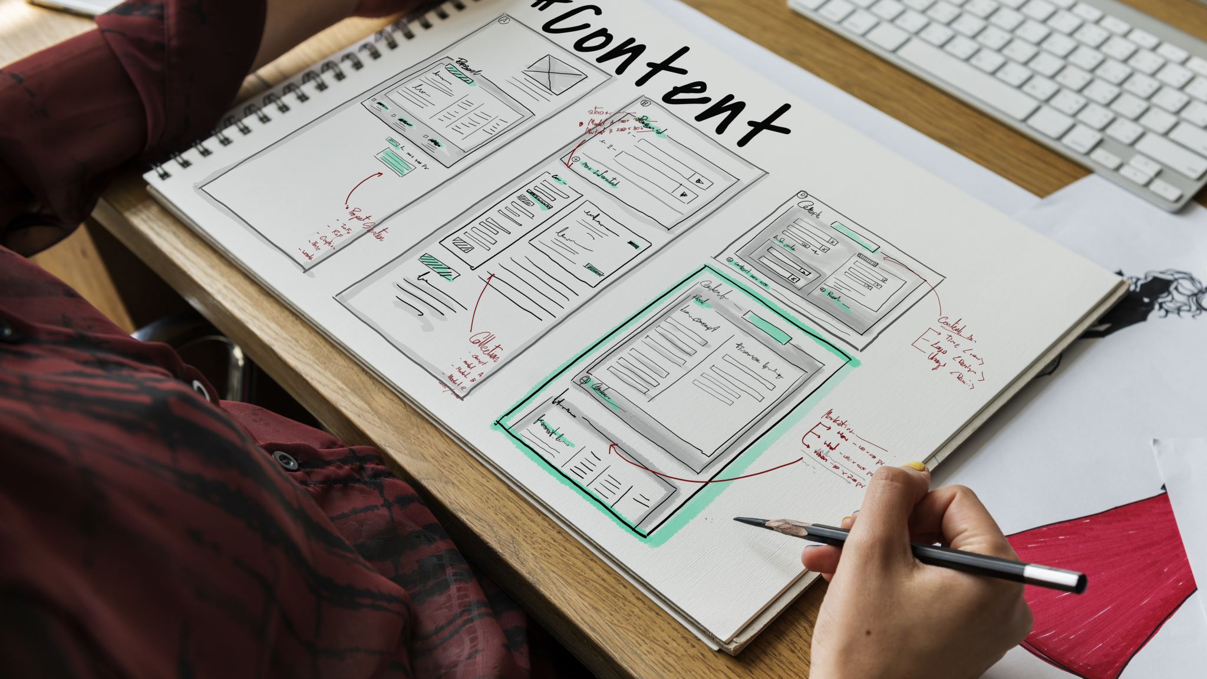
Business Plan

Slide 7
Idea Sketch Pad
Who is the beneficiary of this idea?
Users who wish to share files/folders between devices, such as students
Why is the offering important?
It provides an alternative and cheaper way of transferring files between devices over using paid cloud services
How does the user use our offering?
The user can use our offering by installing the application on devices they wish to use it, and by uploading their files to the application. When any 2 devices are online they will then "sync" their content.

Slide 8
Technologies and tools we used
Java Sockets
Java NIO
JavaFX
SceneBuilder

Slide 9

Project Plan and our Progress

Slide 10
Project plan
We defined the requirements
Timelines, features, other necessary functions
We will design the user interface
UI will be designed considering usability, accessibility, and responsiveness
We will design the application's back-end
Using the technologies we mentioned, we will implement a file transfer protocol
We will test the application
Using methods such as white box testing, we will test the application

Slide 11

Our Progress
So far, we have developed a functional GUI for most parts of the application.
We have developed a large amount of the back-end, functions such as the file transfer protocol and folder syncing
Retrieval from an online database has also been developed to prevent identifier and account details overlap

Slide 12
Challenges that we faced
Lack of documentation for this type of application
There is a small amount of documentation available for the development of an application such as ours, which is why we have had to learn many components of its development as we build it
Lack of clear requirements
This type of application can have hard to define requirements, which can lead to confusion and/or delays
Lack of visual progress
This type of application has minimal visual feedback which results in there being a quick but internally complex use process

Slide 13
Video Demo of our Application
Login Validation
Accessible and robust GUI making the application easy to use
Functional UI components that are self-explanatory

Slide 14
Questions?
We are happy to answer! Please email us if you would like to receive a more in depth answer.
Jake Macken, x21321771@student.ncirl.ie
Adam Malone, x21178691@student.ncirl.ie
Kyle White, x21226695@student.ncirl.ie
Daniel O’Connor, x21437616@student.ncirl.ie

